Slide 1

Aging Population
Thinking and Innovation​
Nepal Team 1
​ Members:​
Ziya Pokhrel Sagar Bhattarai​ Royal Katuwal​
​
Prajwal Bikram Thapa​ Chaitanya Raj Shah​ Aarjanmani Kandel​

Slide 2
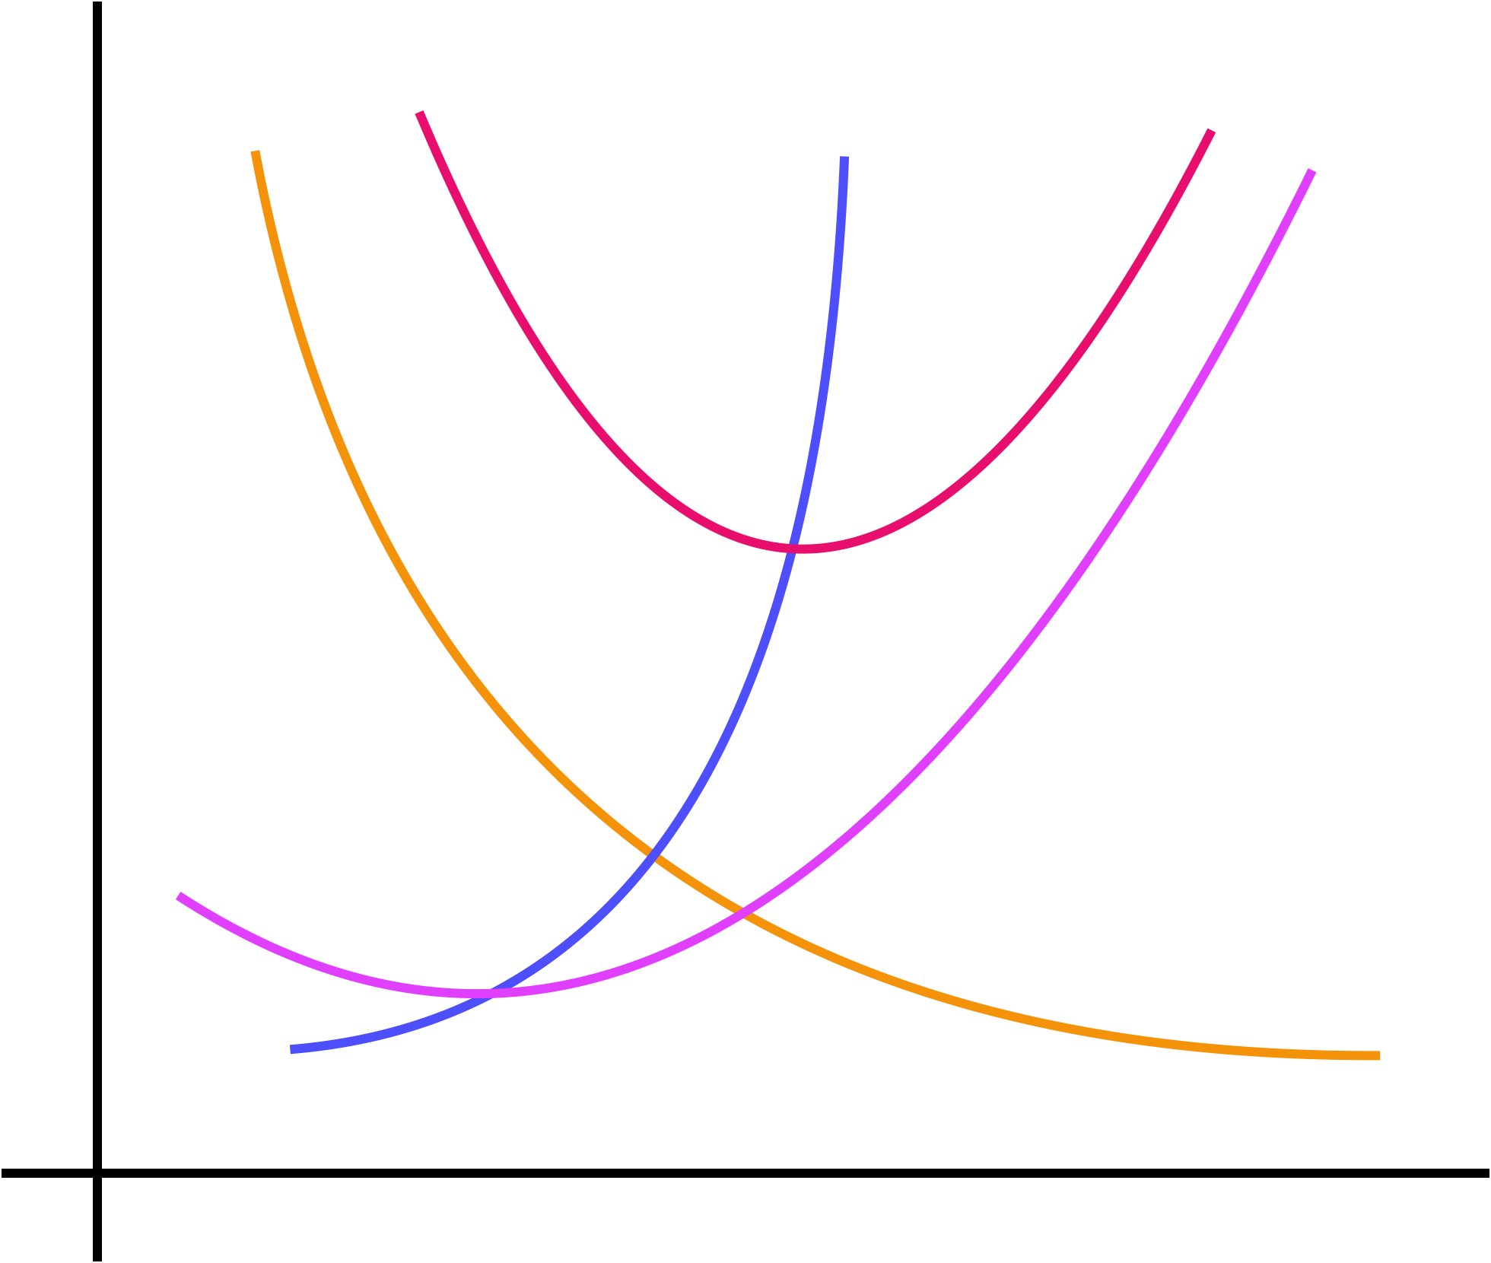
Q1: MC, ATC, AFC, AVC. What decisions should Company W make in short and long term?
ATC
Short-run decisions
- Production at: MR equals MC
- Promotion and Advertisement
- Specialization
Long-run decisions
- Service Differentiation
- Research and Development
- Equity Finance
MC
AVC
COST
AFC
OUTPUT

Slide 3
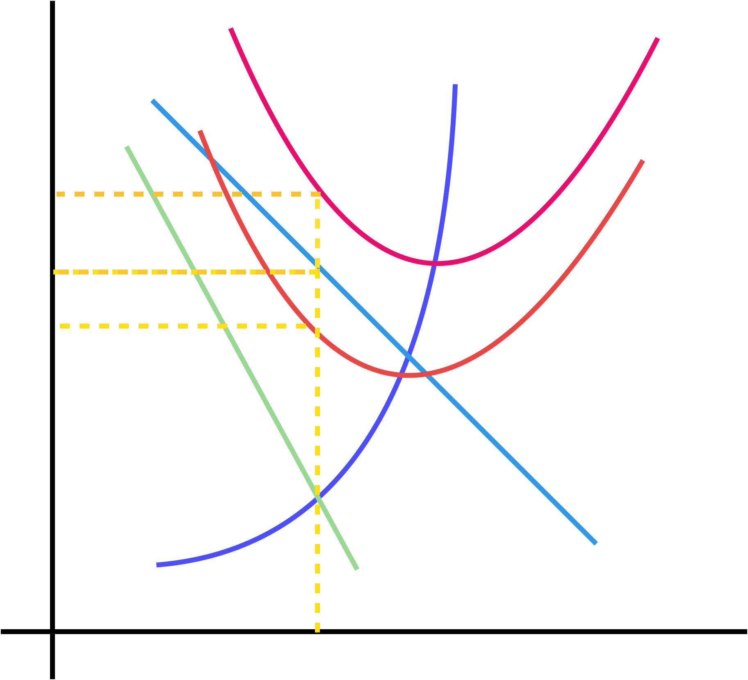
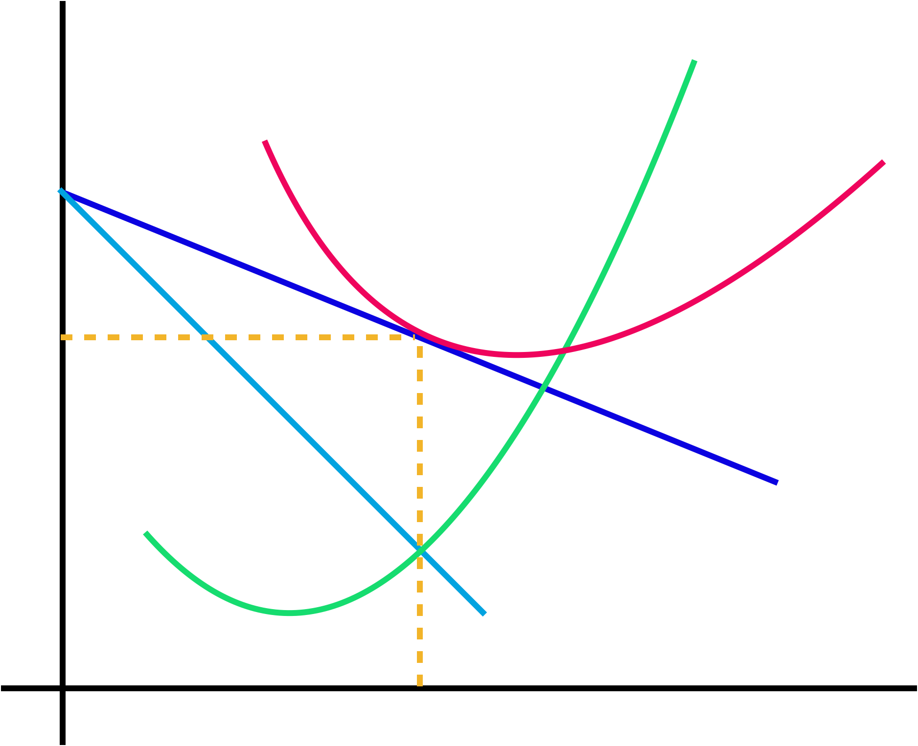
Q2: Market Structure? Losses, profits, and long-run profits. Why will the firm stay?
ATC₂
MC
MC
ATC
ATC₁
LOSS
COST/REVENUE
COST/REVENUE
PROFIT
AR
MR
OUTPUT
​
A monopolistic market structure​
Breakeven condition: AR equals AC
Still enjoys accounting profit
AR
MR
OUTPUT

Slide 4
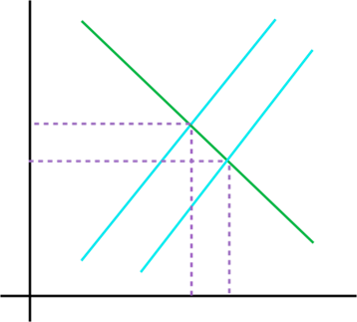
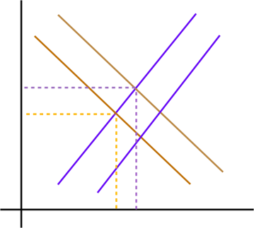
Q3: Nursing homes, type of good? Characteristics? Externality, its consequence, and it's solution
P
S (MPC)
Private Good
- Excludablility and Rivalry
Results in positive externality
- MSB > MPB
Underallocation of merit goods
Measures to solve the externality:
- Nudging
- Provision of Subsidy
- Provision of Information
S₁ (MSC = MPC – Subsidy)
E
E₁
P
S (MPC)
D (MPB)
E
S₁ (MSC = MPC – Subsidy)
Qty
Positive externality due to subsidy
E₁
D₁
(MSB = MPB + MEB)
D (MPB)
Qty
Positive externality due to consumption

Slide 5
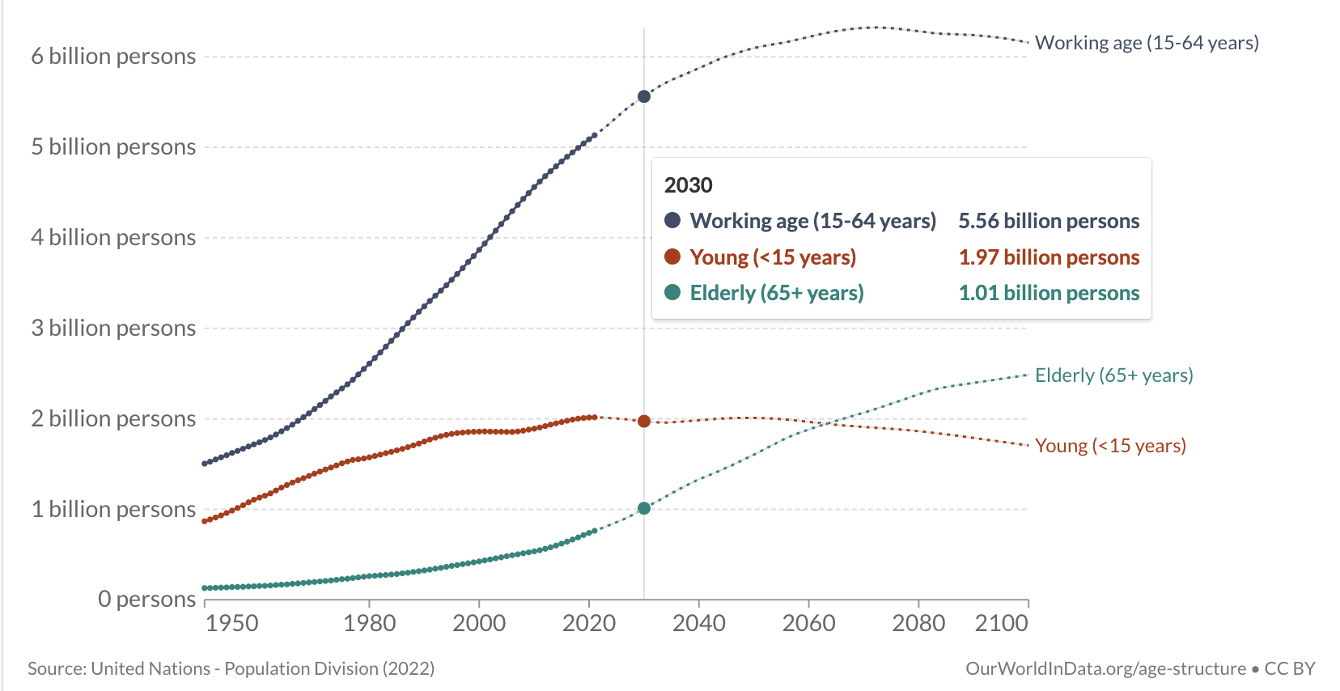
Problem: Increase in elderly population is likely to overburden healthcare system with increase in the consumption of healthcare resources in long-term
Theory of demographic transition is applicable
Developed countries tend to have a lower fertility
Mortality rates are low, birth control is easily accessible
Children considered as economic drain
Women have children late in life
Workforce expected to fall by 8 million by 2030
Increase in dependency ratio
Younger population need to be overworked, giving them less time and making having children more and more unattractive
Leads to decline of young and working people in contrast to increasing old; creating creates a viscous cycle

Slide 6

Solution 1(a): Voluntary awareness of good health practices
Redesigning daily routine incorporating more physical activity and necessary supplements
Developing a positive social well being
Being focused on Healthy Aging
Reducing the consumption of synthetic chemicals
Consuming a balanced diet
Keeping the mind active by engaging in social activities and learning new skills

Slide 7
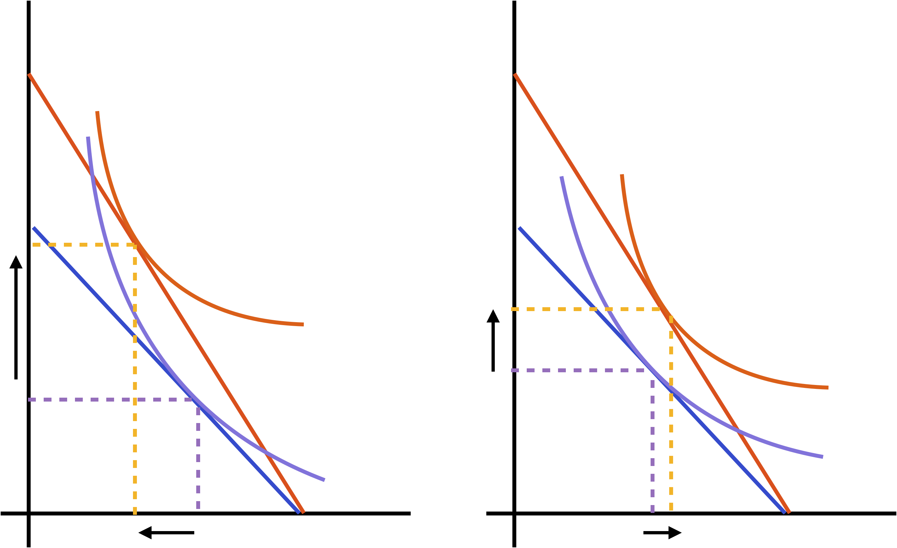
Solution 1(b), Economic Theory: Theory of Consumer Choice
Employers provide employer matching contributions.
Contributing a certain amount of income to such retirement plans will lead to greater income to consume when old.
More access to health services when old.
Can be explained based on:
- Substitution effect
D to E
- Income effect
E to F
Consumption when old
Consumption when old
BC₂
BC₂
.
F
.
.
E
E
.
F
BC₁
BC₁
I₂
.
.
D
I₂
D
I₁
I₁
Consumption when young
Consumption when young
D: initial optimum F: final optimum

Slide 8
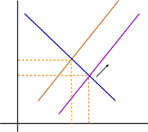
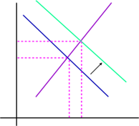


Solution 1(b), Economic Theory: Aggregate Demand
Interest
Rate
S₁
S₂
At macro level, this will increase the supply of​ loanable funds in the loanable funds market​ which will cause interest rates to fall down and ​ hence as a result increases investment.
The ​Increase in investment will increase the aggregate​demand at any given price level (right shift in​ AD curve) increasing the output.
Price
level
AS
D
Loanable Funds
AD₂
AD₁
Real GDP

Slide 9

Solution 2: Company should invest in new technologies that aids productivity
Introduction of Internet of Medical Things (IoMT)
Collection of medical devices and applications communicating with health care information technology system via online computer networks.
The overall IoMT market is expected to grow from $41 billion in 2017 to $158 billion by 2022 (Deloitte survey).
The scope includes In-home IoMT, On-Body IoMT, Community IoMT and In-Hospital IoMT.
Government can subsidize such new innovations and create incentive for the producers.

Slide 10

Solution 2: Telehealth services as an alternative
Telehealth services as an alternative
Connecting with your health care provider online is a great way to get the health care you need from the comfort and safety of your own home.
The global telehealth market size was valued at USD 83.5 billion in 2022 and is projected to expand at a compound annual growth rate (CAGR) of 24.0% from 2023 to 2030.
Frictionless financial transaction ecosystem
Spend less on less on administrative spending and more on delivery of care. Here companies can build a frictionless financial transaction ecosystem that cuts administrative costs of health care

Slide 11
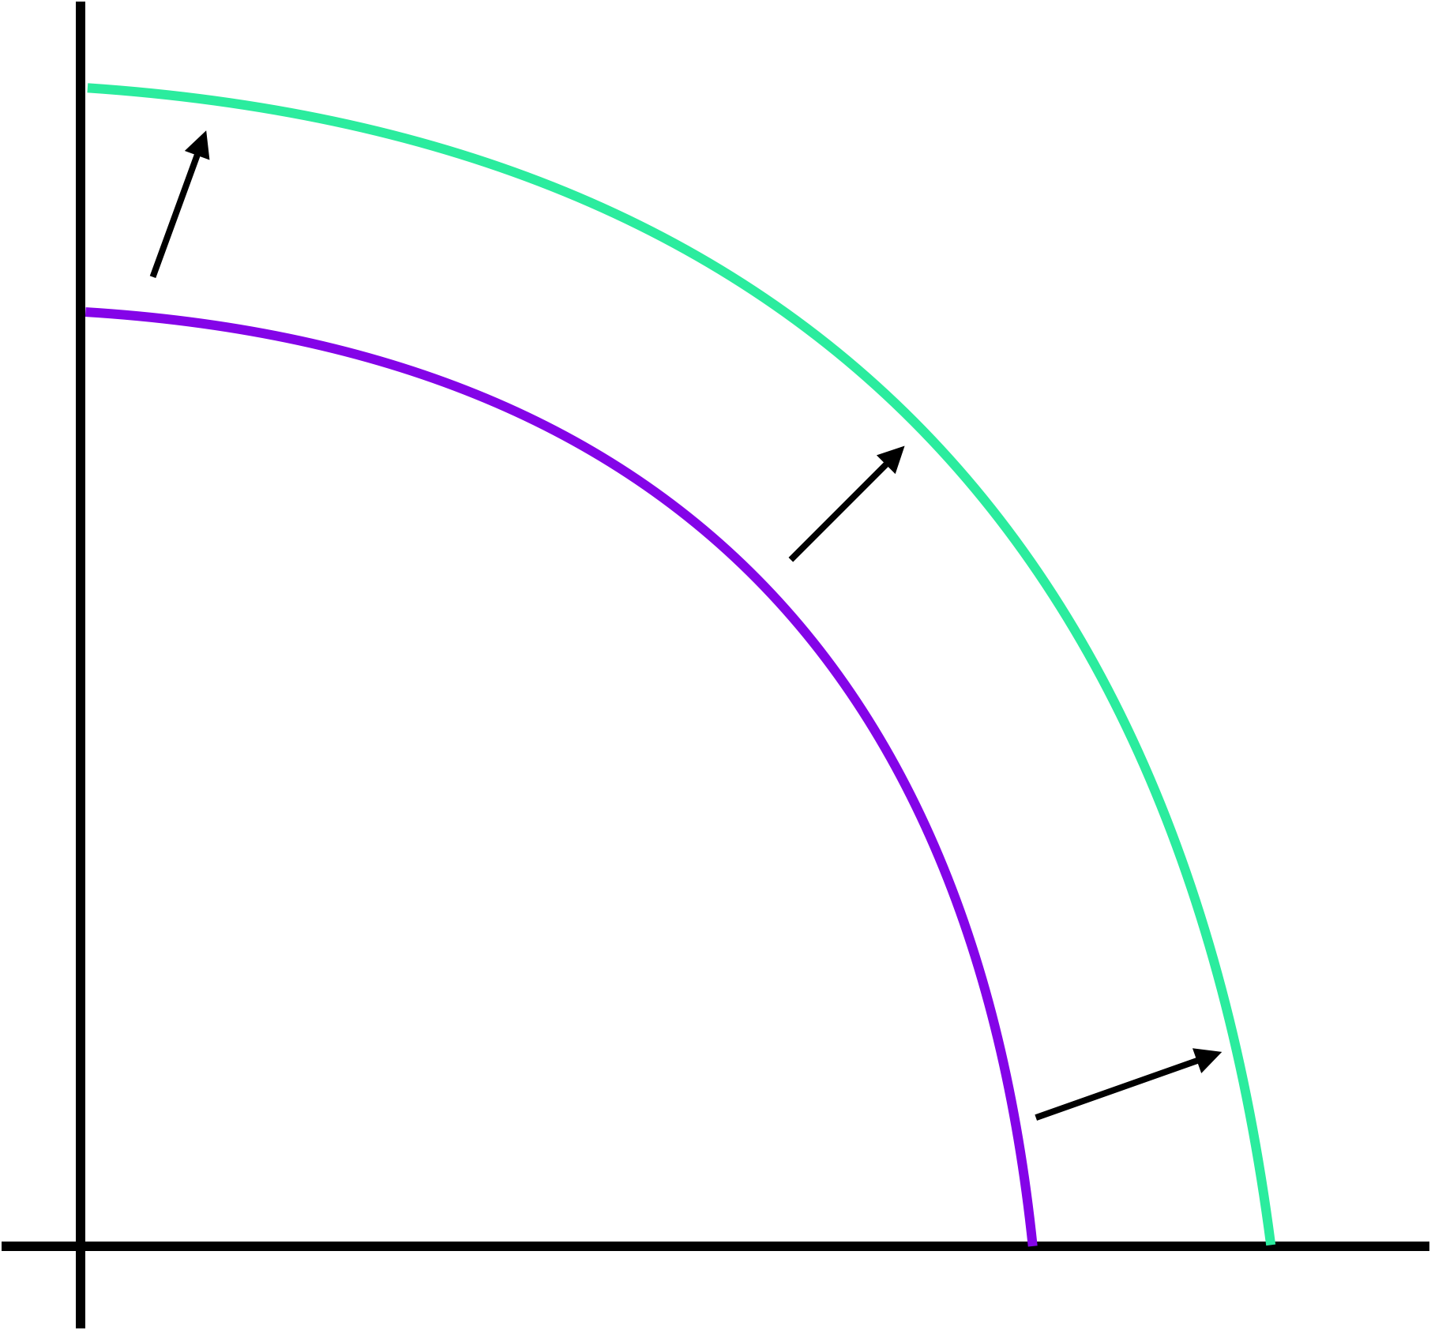
Solution 2, Economic Theory: PPC Shift
X
Technological investment boosts the productivity of healthcare delivery systems.
New technologies installed the delivery systems are now more efficient and requires less human capital​.
Y
Outward shift in PPC

Slide 12
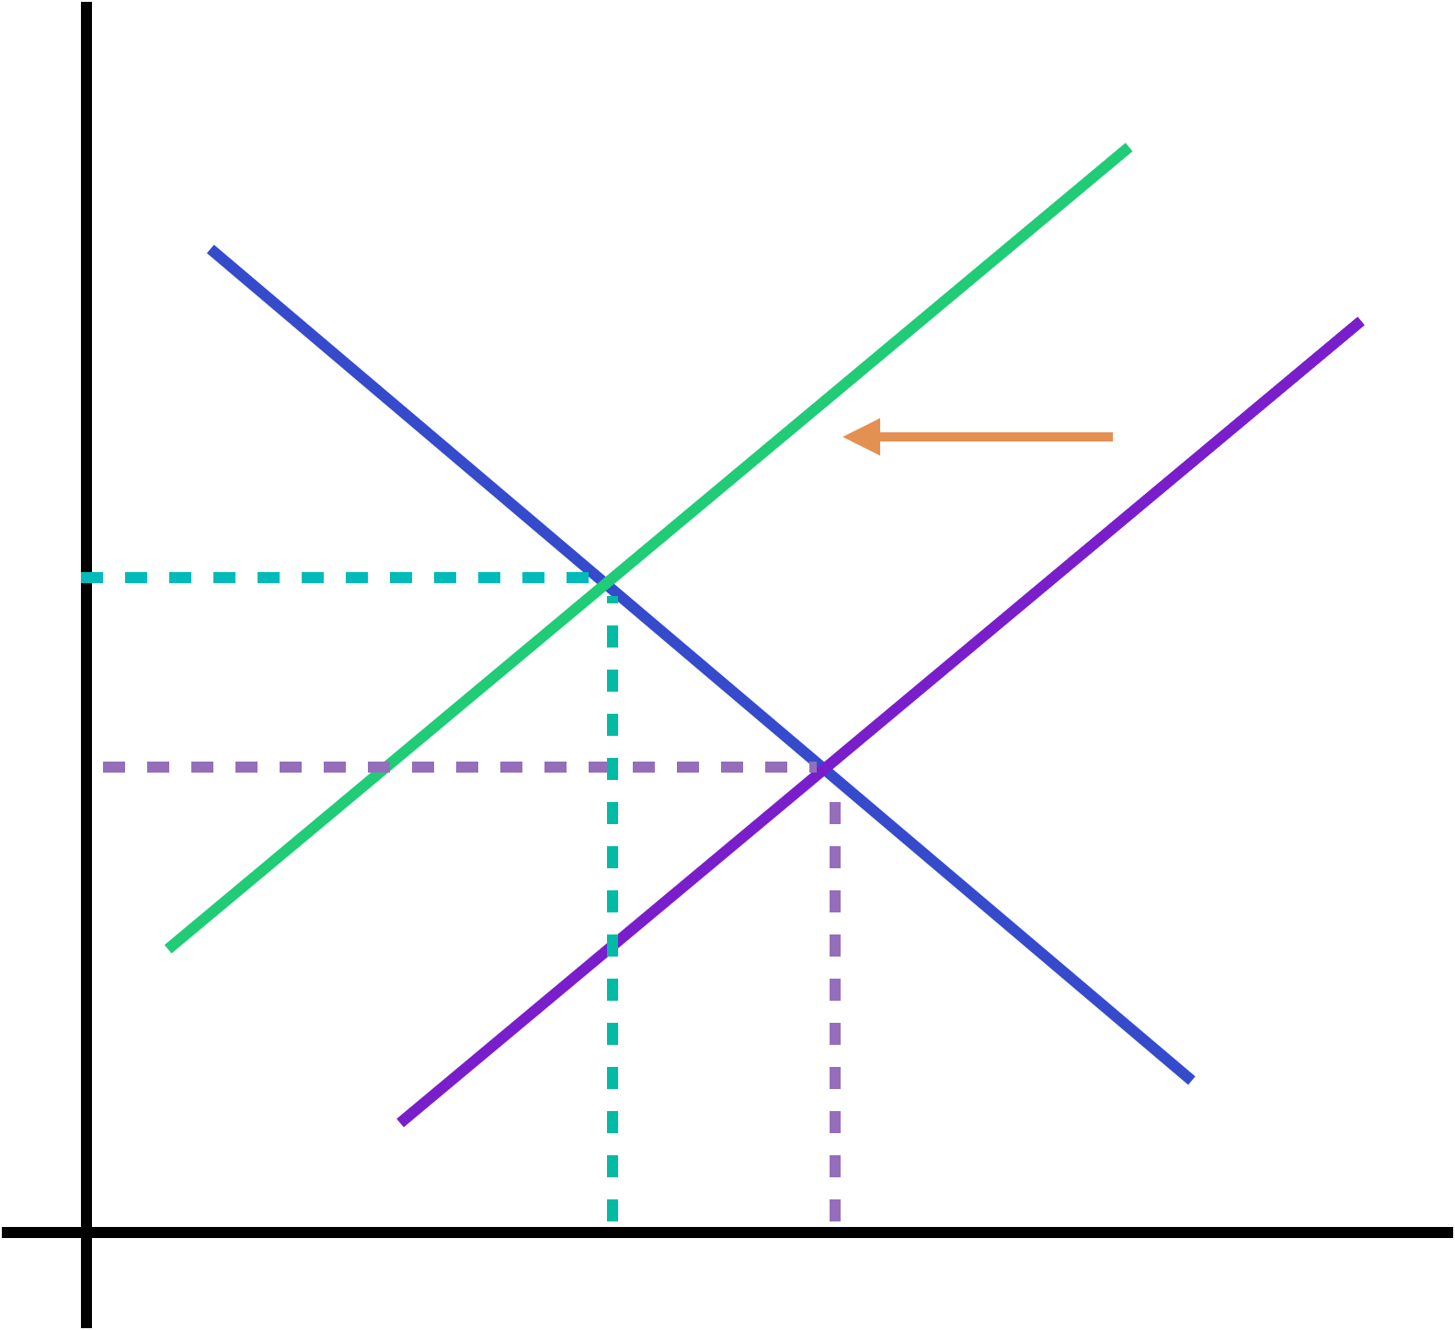
Solution 3(a): Tax negative externalities that expose elderly population to disease and use the proceeds to fund and strengthen health care
Price
S₁ (MSC = MPC + tax)
Negative externality exists when the services have additional cost to the third party.​
Air pollution can aggravate heart disease and stroke, lung diseases such as chronic obstructive pulmonary disease and asthma, and diabetes.​
Industry that produces pollution that expose risk of diseases to the elderly population should be taxed. (Internalizing the externality)​
The tax collected can be utilized by Government to fund and strengthen health care
S (MPC)
E₁
E
D (MPB)
Negative externality due to production
Qty

Slide 13
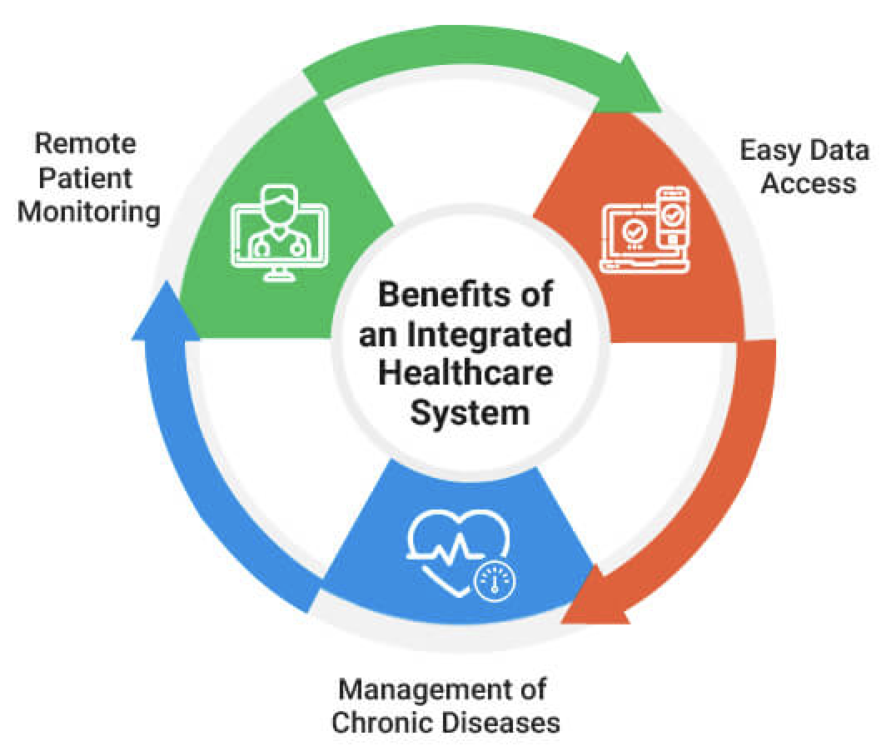
Solution 3(b): Changing Traditional System to Integrated Health care
Integrated approach focused on building and maintaining older people's physical and mental capacity.
Assessment of the older person's goals and their capacity and their physical and social environments.
This assessment enables health and social care professionals together with the older person and their caregivers to develop a care plan.
It leads to:
Your physical and mental health needs being addressed,
Better collaboration between your health providers, and
Less stress navigating the complicated health care system.

Slide 14
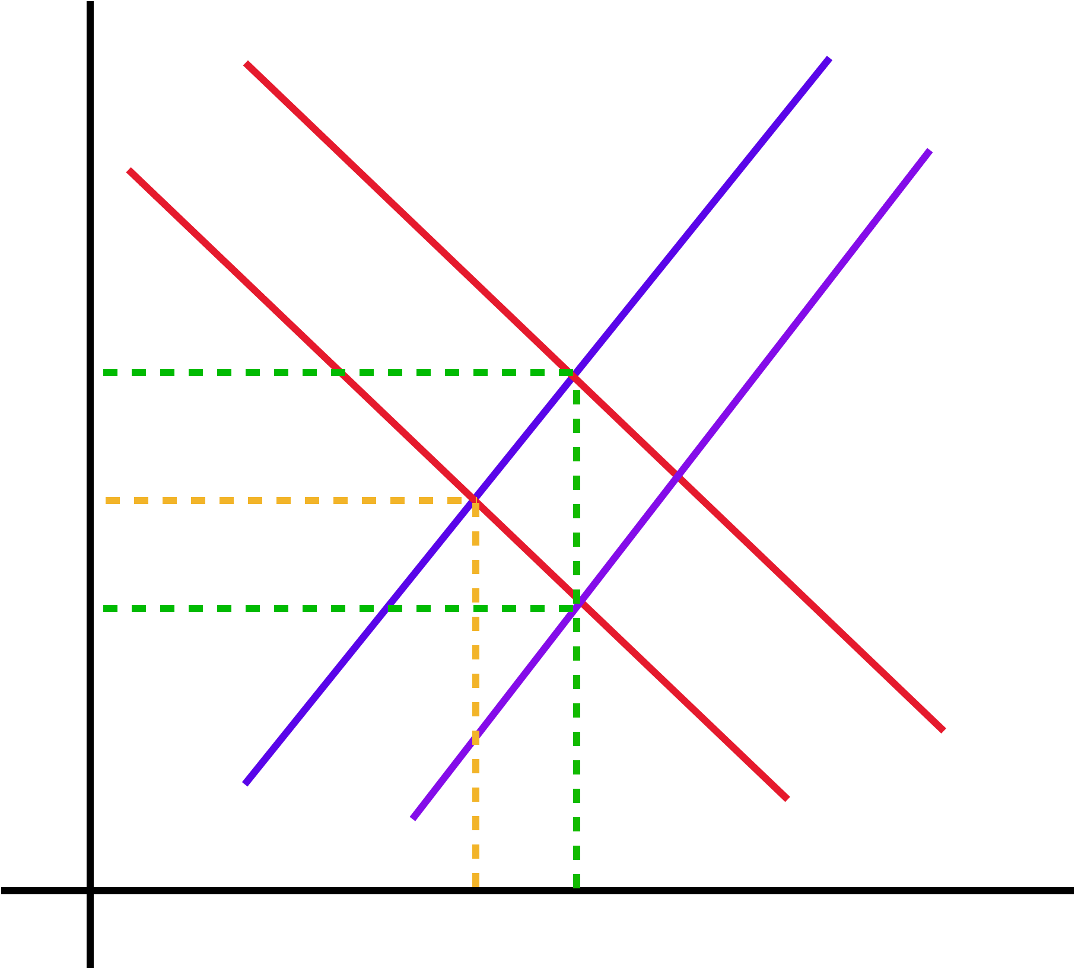
Solution(b), Economy Theory: Externality
A positive externality exists if a good or service has benefit to the third party
Medical Education creates a positive externality:
- Increases health awareness of individual
- Sanitation and Awareness increases in society
Subsidy = P0-P2
The supply curve shifts to S2 and price falls from P1 to P2
People will consume more; Quantity increases from Q1 to Q2
The output (Q2) is social efficient: because here Social marginal cost (SMC) = Social marginal benefit (SMB)
P
S = PMC = SMC
S₂
P0
P1
P2
SMB
D = PMB
Q1
Q2
Qty

Slide 15
Conclusion:
Solution 1: When individuals (employees) participate in employee matching contribution, it reduces government pressure to fund public health care services to aging population
Economic Theory: Theory of Consumer Choice
Solution 2: Company should invest in new technologies that aids productivity
Economic Theory: Production Possibility Curve
Solution 3: Tax negative externalities that expose elderly population to disease and use the proceeds to fund and strengthen health care
Economic Theory: Internalizing the externality
Limitations of suggested solutions:
- The protocols and security standards for these types of integrations change constantly which causes problem of compatibility.
- Standarization is hard to achieve in Integrated health care system with differences in system and format for storing data.
References:
https://www.oecd.org/economy/growth/46508800.pdf
https://www.oecd-ilibrary.org/docserver/health_glance-2015-39-en.pdf?expires=1668303679&id=id&accname=guest&checksum=C6AB91EEFE1060B1A2632236F0A6711D
https://ourworldindata.org/grapher/dependency-age-groups-to-2100

